Slide 1

Theory of Computation
Regular Expressions
王轩
Wang Xuan

Slide 2
Outline
Regular Expressions
Prove Regular Language = Regular Expression
Generalized NFA
1

Slide 3

Regular expressions describe regular languages
Example: (0 ∪ 1)0*
Example: describes the language
2

Slide 4
Regular Expressions
Given an alphabet Σ, R is a regular expression if R is
  a, for a∈Σ
  ε
  ∅
  (R₁•R₂), with R₁ and R₂ regular expressions
  (R₁∪R₂), with R₁ and R₂ regular expressions
  R = (R₁*), with R₁ a regular expression
  Notice: do not confuse regular expressions ε and ∅
3

Slide 5
Example
Σ = {0,1}
1. 0*10* = {w| w has exactly a single 1}.
2. Σ*1 Σ* = {w| w has at least one 1}.
3. (Σ Σ Σ)* = {w| the length of w is a multiple of three}.
4. 0Σ*0 ⋃ 1Σ*1⋃0 ⋃1 = {w| w starts and ends with the same symbol}.
  5. (0⋃ε)1* = 01*⋃1*.
      The expression 0⋃ε describes the language {0, ε}, so the concatenation operation adds either 0 or ε before every string in 1*.
4

Slide 6

Regular Language = Regular Expression
Language={ ..|….} Experssion: (a+b)C+(d.g)*
Languages
Generated by
Regular Expressions
Regular
Languages
5

Slide 7


Proof: We need to prove both ways
Languages
Generated by
Regular Expressions
Regular
Languages
Languages
Generated by
Regular Expressions
Regular
Languages
6

Slide 8
Proof: part 1
LEMMA 1:
If a language is described by a regular expression, then it is regular.
Idea:
Regular expression R describing some language A. We show how to convert R into an NFA recognizing A.
7

Slide 9
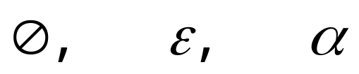
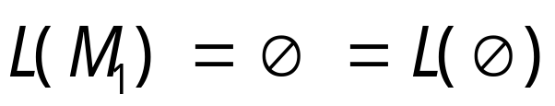
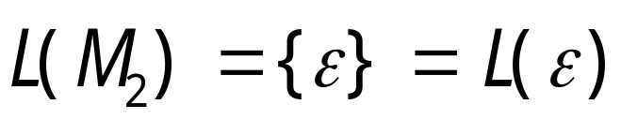
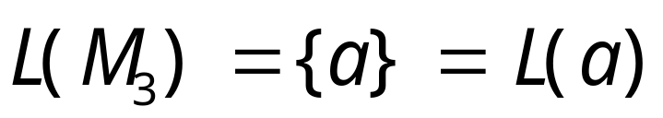

Proof
Primitive Regular Expressions:
Corresponding NFAs
regular
languages
8

Slide 10
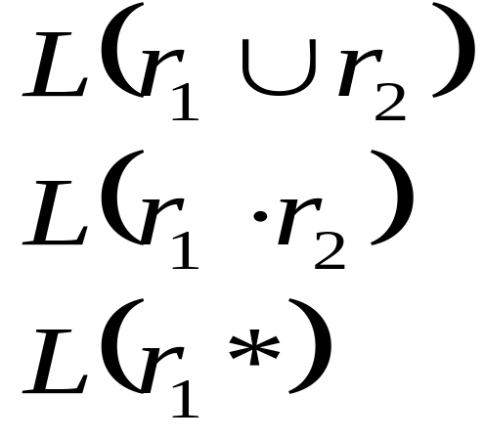
Inductive Hypothesis
Suppose that for regular expressions r₁ and r₂, L(r₁) and L(r₂)are regular languages
We will prove:
Are regular
Languages
9

Slide 11
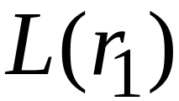
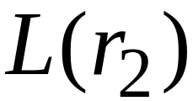
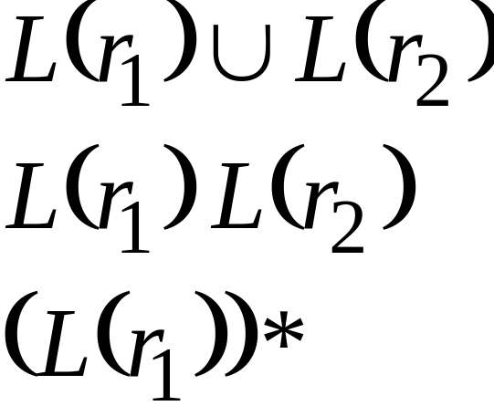
By inductive hypothesis we know:
and are regular languages
We also know:
Regular languages are closed under:
Union
Concatenation
Star
10

Slide 12
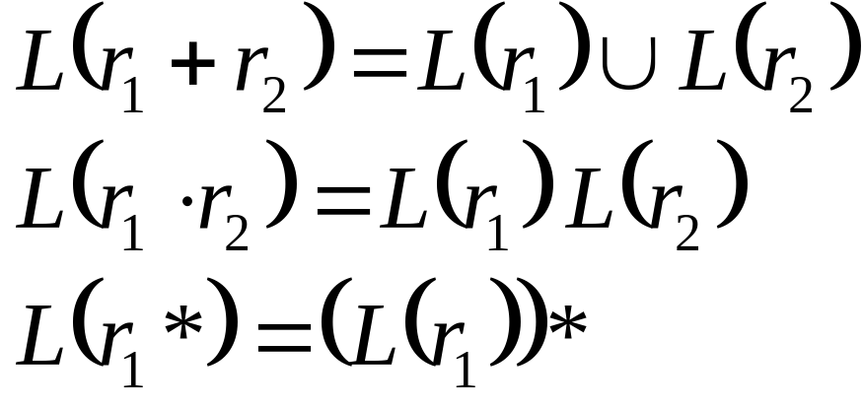
Therefore:
Are regular
languages
End of Proof-Part 1
11

Slide 13




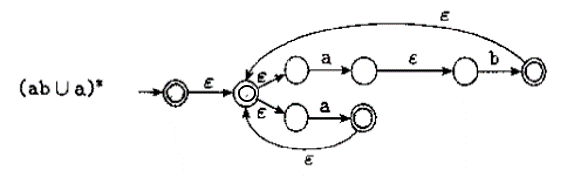
Example
Regular expression (ab ∪a)*
12

Slide 14
Proof: part 2
LEMMA 2：
If a language is regular, then it is described by a regular expression.
Idea:
A procedure for converting DFAs into equivalent regular expressions.
Two steps
  1 Regular Language is recognized by DFA . We can transform DFA to GNFAs
  2 Transform GNFAs to Regular Expression
13

Slide 15
Generalized NFA
Generalized non-deterministic finite automaton M=(Q, Σ, δ, q_{start}, q_{accept}) with
  Q finite set of states
  Σ the input alphabet
  q_{start} the start state
  q_{accept} the accept state
  δ:(Q-{q_{accept}})×(Q-{q_{start}}) → R the transition function
  (R is the set of regular expressions over Σ)
  The only difference: the edge is Regular Expression in GNFA
14

Slide 16
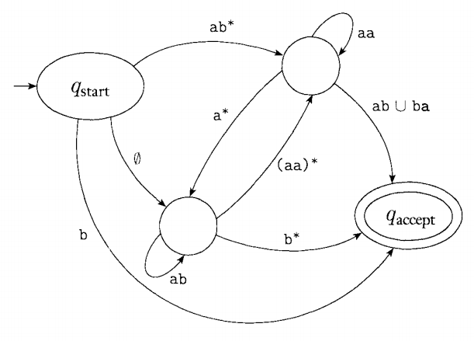
Example GNFA
15

Slide 17
Characteristics of GNFA’s δ
The start state has transition arrows going to every other state but no arrows coming in from any other state.
There is only a single accept state, and it has arrows coming in from every other state but no arrows going to any other state. Furthermore, the accept is not the same as the start state.
Except for the start and accept state, one arrows goes from every state to every other and also from each state to it self.
16

Slide 18
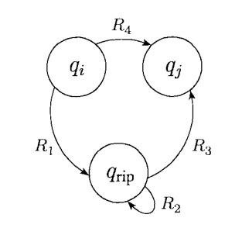
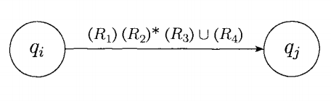
Converting Example
before after
17

Slide 19
Convert
1. Let k be the number of states of G
2. If k=2, then G contains of a start state, an accept state and a single arrow connecting them and labeled with a regular expression R
3. If k>2, select q_{rip}∈Q different from q_{start} and q_{accept} and let G’ be GNFA(Q’, Σ, δ’,q_{start},q_{accept}), where
Q’=Q-{q_{rip}}
18

Slide 20
And for any q_{i} ∈Q’-{q_{accept}} and any q_{j} ∈Q’-{q_{start}} let
δ’(q_{i},q_{j})=(R1)(R2)*(R3) ∪(R4)
R1= δ(q_{i},q_{rip}), R2= δ(q_{rip},q_{rip}),, R3= δ(q_{rip},qj), R4= δ(q_{i},q_{j})
4. Computer convert(G’) and return the value.
R₁
q_{rip}
R₂
R₄∪(R₁R₂*R₃)
q_{i}
R₃
=
q_{i}
q_{j}
R₄
q_{j}
19

Slide 21
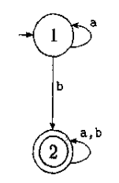
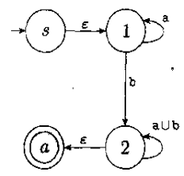
Example
1. First make a four state GNFA by adding a new start state and a new accept state
Replace the label a, b on the self loop at state 2 with label a∪b(figure b)
(a)
(b)
20

Slide 22
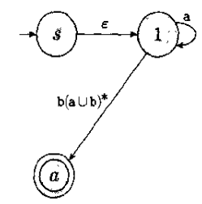
Example
2. Remove state 2, and update the remaining arrow labels(figure c)
State q_{i} is state 1, state q_{j} is a, and q_{rip} is 2, so R1=b, R2=a ∪ b,R3= ε,R4= ∅. Therefore the new label on the arrow from 1 to a is (b)(a ∪ b)*(ε) ∪ ∅, simplify as (b)(a ∪ b)*.
(b)
(c)
21

Slide 23
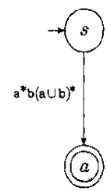
Example
3. Follow same procedure and remove state 1 (figure 4).
(c)
(d)
22

Slide 24
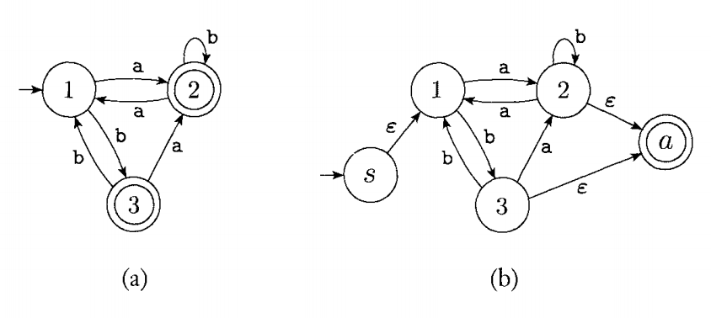
Example(2)
Add new start state and new end state
23

Slide 25
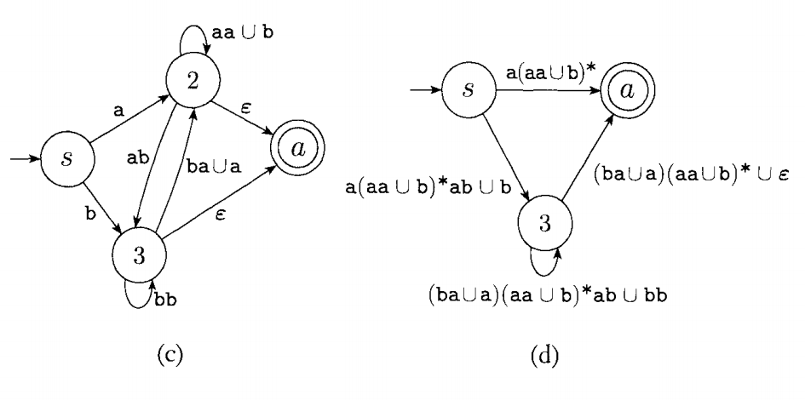
Remove state 1 and state 2
24

Slide 26
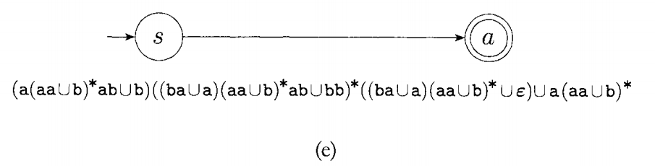
Remove state 3 and obtain the regular expression
25

Slide 27
Language={ ..|….} Experssion: (a+b)C+(d.g)*
Languages
Generated by
Regular Expressions
Regular
Languages
26

Slide 28
Review
Regular Expressions
Prove Regular Language = Regular Expression
Generalized NFA
27

